Slide 1
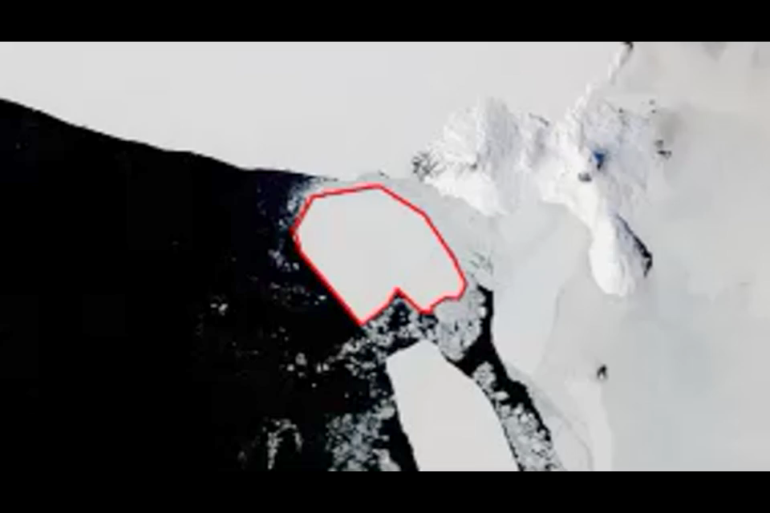
B - Perceptually-based approach with simple linear interpolation
1
Notes:
Method
- the matching between source and target polygons is performed using a morphing algorithm (the perceptually-based approach);
- the vertex correspondences are computed by linear interpolation only. Rotation and translation are represented implicitly by the movement of the vertices
Issues
- this solution is not safe because it may generate invalid topologies during the transformation of a source into a target polygon; this is not the case using the icebergs datasets;
- when rotation is important, the object tends to shrink and grow during a transformation (see 11-15 seconds in the movie).

Slide 2
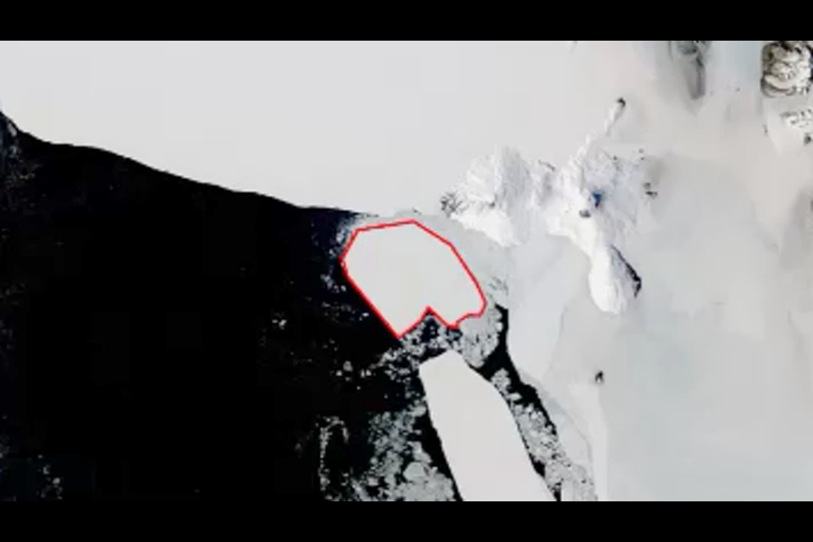
C – rotating plane modified
2
Notes:
Method
- This is an alternative implementation of the solution proposed in <McKenney, M., Webb, J., 2010. Extracting moving regions from spatial data. Proc. of 18th SIGSPATIAL Conf. on Advances in GIS, ACM, 438-441>.
- The movement of the object is modeled by 3 components: the translation and the rotation of the whole object; the movement of the vertices, which model only the deformation of the object; (in the original proposal the movement of the vertices models translation + rotation + deformation).
Issues
- this solution has the same advantages (the algorithm is safe) and disadvantages (concavities are mapped to a point causing deformation during the transformation).

Slide 3
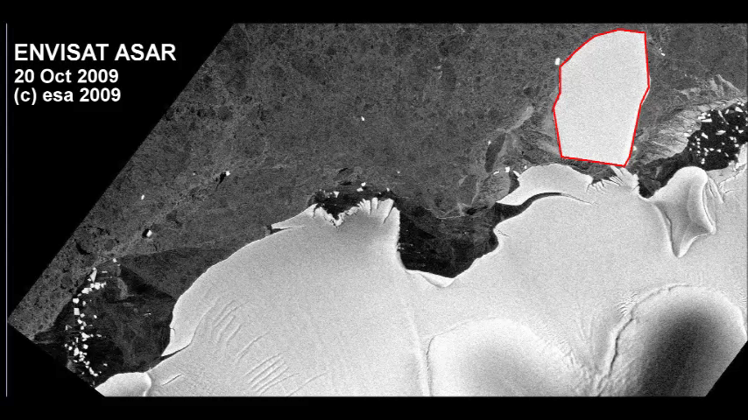
B - Perceptually-based (another example)
3

