Slide 1
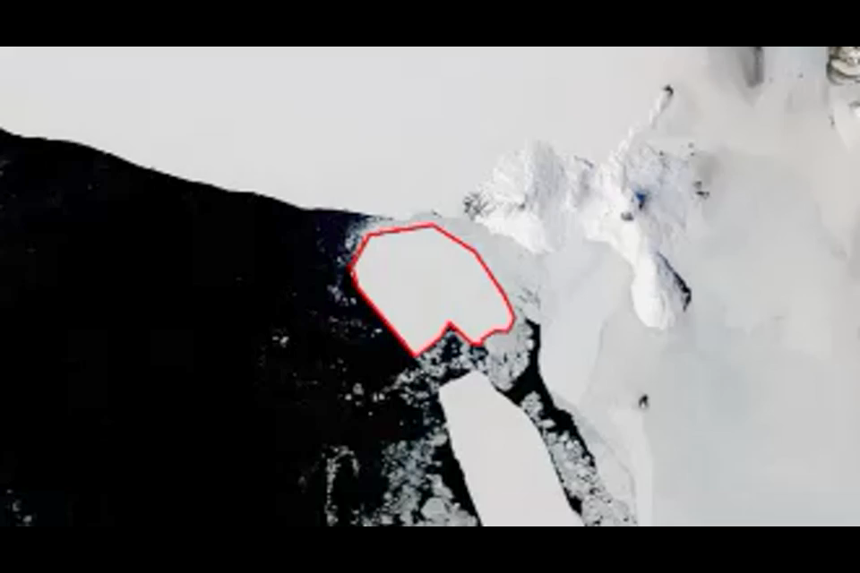
Approach : C – Rotation plane
    .
1
Notes:
method
- This is the solution proposed in <McKenney, M., Webb, J., 2010. Extracting moving regions from spatial data. Proc. of 18th SIGSPATIAL Conf. on Advances in GIS, ACM, 438-441>.
- The mapping between source and target polygons starts with the lower-left vertices, even if the polygon rotates;
- Concavities are mapped into points;
- Uses moving segments instead of moving points.
issues
- The objects tend to plump during rotations;
- Concavities degenerate during the transformation;
- The intermediate shapes are less ‘natural’ then when using previous algorithm.
but
- this solution is safe!

Slide 2
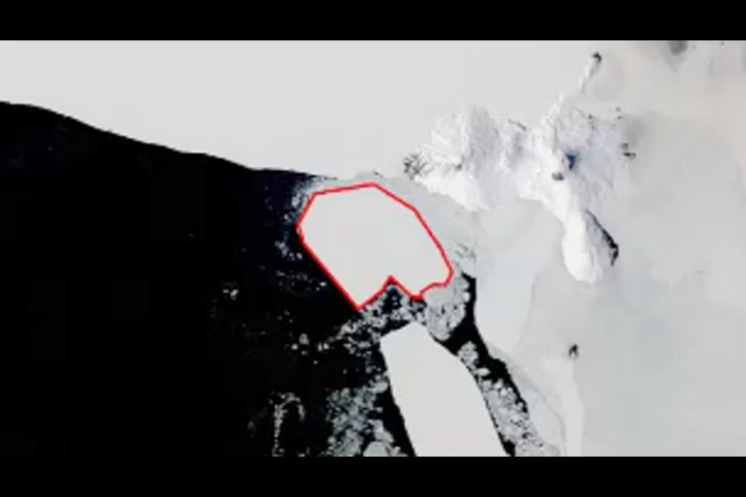
Approach: B – Perceptually-based
2
Notes:
Method
- source and target polygons are aligned before defining the correspondences;
- the movement of the object is modeled by 3 components: the translation and the rotation of the whole object; the movement of the vertices, which model only the deformation of the object; (in previous solutions the movement of the vertices models translation + rotation + deformation).
Issues
- the fidelity of movement representations increases significantly…
… but this solution is not compatible with current spatiotemporal database models;
and it is harder to implement in databases

