Slide 1
Software Defined Radio PhD Program on Electrical Engineering
Introduction to DSP Architectures and Real-Time Realizations
José Vieira

Slide 2
Summary
Main DSP companies
Brief Introduction to the DSPs
The dot product on the architecture of the DSPs
The Harvard architecture
The VLIW and the SIMD architectures
The evolution of the DSPs
The CELL processor
The roles of FPGAs and DSPs on SDR

Slide 3
Main DSP Producers
Texas Instruments (www.ti.com)
TMS320: C1x,C2x,C5X;C80;C60
Analog Devices (www.analog.com/dsp)
ADSP-21xx (SHARC)
AT&T(www.lucent.com)
DSP16xx;DSP32xx
Motorola (www.motorola.com)
DSP561xx,DSP5600xx,DSP96xx
NEC, Zoran etc.

Slide 4
The Pioneers
1978 – AMI S2811, first designed DSP, on the market in 1982
1979 – AT&T DSP1
1980 – NEC μPD7720
1982 – Texas Instruments TMS320C10
1982 – Hitachi HD61810 first floating point DSP

Slide 5
Breve história dos DSPs
Floating Point
TI–70% of the market
Analog Devides 2º
VLIW and SIMD
Fixed Point
1980
Development
1990
Consolidation
2005
MDP7720
TMS320C30
TMS320C10
ADSP2100
TMS320C6000
BLACKFIN
AT&TDSP32
TMS320C5000
Tiger SHARC
DSP56000
TMS320C40
Fonte: M. E. Angoletta
TMS320C80

Slide 6
Dot Product
The DSP has an architecture different from the other processors by having is internal architecture optimized to perform dot products efficiently
The dot product operation has a main roll in most of the DSP algorithms
Convolution
Correlation
FFT
Matrix calculations

Slide 7
Dot Product

Slide 8
DSP Algorithms
Convolution, correlation, product between two matrices
Multiplication and Accumulation (MAC) A*B+C=C
Reads two numbers from memory
Multiplication
Add
Moving data in memory
Goal of the architecture: to perform one MAC in one clock cycle

Slide 9
Main characteristics of the DSPs
Data Path
Multiplier, accumulator, address generator
Internal multi-access memories
Special addressing modes
Execution control
In / Out

Slide 10
Structure of a Generic DSP
Core

Slide 11
Von Neumann Architecture
Data and Program share the same bus
Mem
Add
CPU
Data

Slide 12
Harvard Architecture
Data and program use different buses
CPU
Program
memory
Add
Add
Data
Memory
Instruction
Data

Slide 13
Harvard Architecture
Implementation of Tap by cycle FIR filter:
Reads the instruction opcode- MAC
Reads one sample from the delay line
Reads the coefficient
Update the delay line
4 memory access by cycle

Slide 14
Harvard Architecture – First Version
CPU
Program
Memory
Add
Add
Data Memory
Instr
Data
%FIR using the TMS320C10
LT *-,Ar1; T=*delay line
MPY *-,AR0; multiplies by the coef
LTD *-,AR1; accumulate,move,T=*delay line
MPY *-,AR0
.....
Two memory access by coef

Slide 15
Harvard Architecture – Second Version
CPU
Memória
De
Programa
Data and Program
Memory
Add
Data Memory
Add
Intruction
Data
%FIR EM TMS320C2x
MACD m1,m2
% 1 tap in 2 cycles
Withou the reading of the Opcode
1 TAP/CICLO
RPTK Constant
MACD m1,m2

Slide 16
Harvard Architecture – Other Versions
3 banks of internal memory (1 program + 2 for data, ex: Motorolas, C30).
Fast Memories – 2 or access by clock cycle - (ex: C30)
Multiport memories- (ex:C50)
Special memory operations

Slide 17
VLIW Architectures
Multiple instructions are coded in one long word with 256 bits.
Several parallel buses for high throughput
The VLIW (Very Long Instruction Word)architectures has several parallel processing units
The compiler has to take care of all the dependencies when distribute the tasks by the severl processing units
Very difficult to program in “assembly”.
Main goal: obtain efficient code by programming in C

Slide 18
VLIW Architectures

Slide 19
VLIW Architectures
Inst1
Inst2
Inst3
Inst4
Inst5
Inst6
Inst7
Inst8
L1
S1
M1
D1
L2
S2
M2
D2
8 instruction of 32 bits
Processing Units

Slide 20
SIMD
SIMD - Single Instruction Multiple Data
The processor executes the same operation on multiple data
One multiplier of 64 bits can perform 4 mul of 16bits
Efficient use of the resources
Difficult to program and requires an organized data

Slide 21
Processors Using SIMD
TMS320C6000 da Texas Instruments
TigerSHARC da Analog Devices
BlackFin from Analog Devices
Intel Pentium (MMX)
Power PC (AltiVec)

Slide 22
SIMD

Slide 23
SIMD + VLIW– TigerSHARC

Slide 24
Looking Inside the DSPs
The main DSP inovations

Slide 25
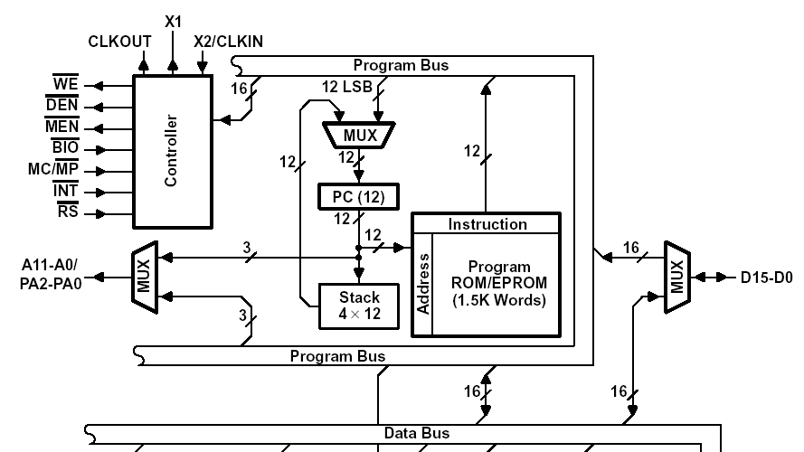
1981 – TMS320C10 from TI

Slide 26
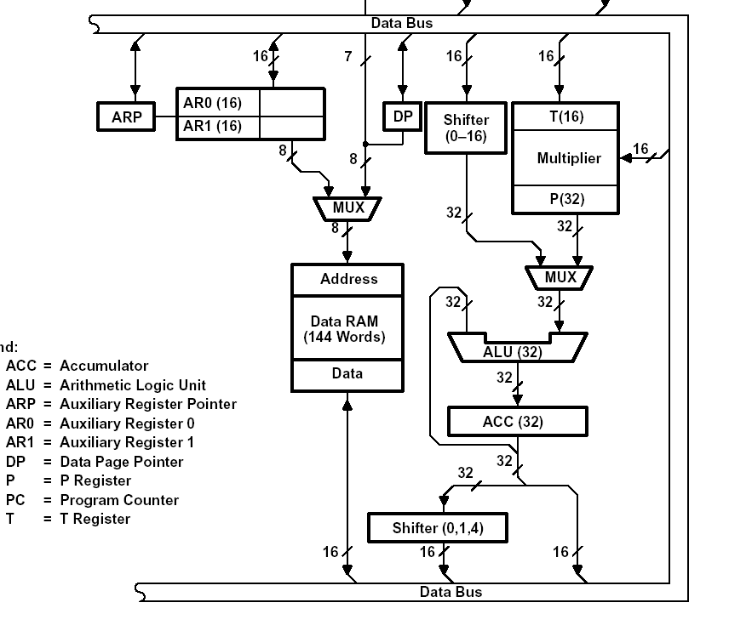
1981 – TMS320C10 from TI

Slide 27
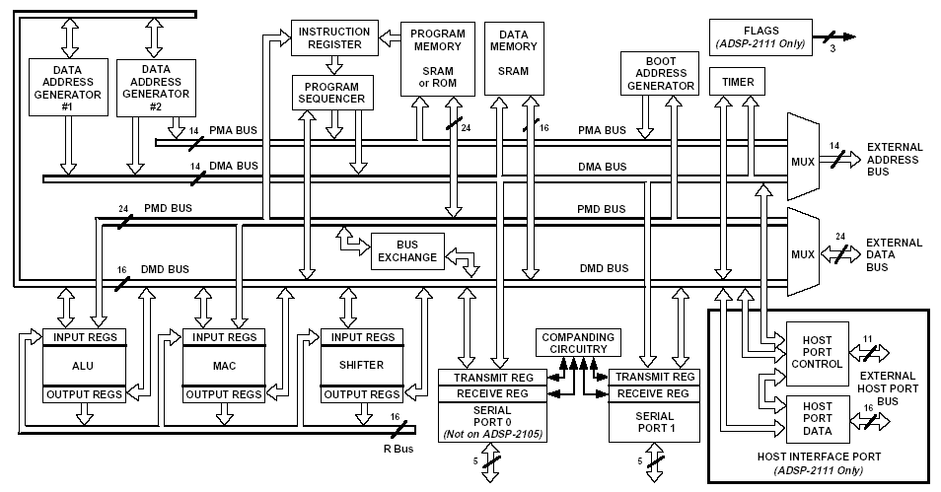
1986 – ADSP 2100 from AD

Slide 28
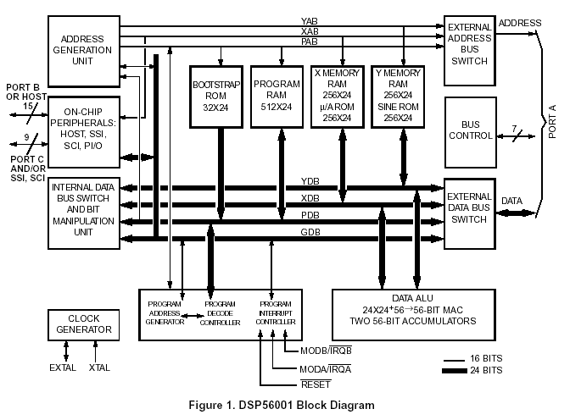
1987 – DSP56001 from Motorola

Slide 29
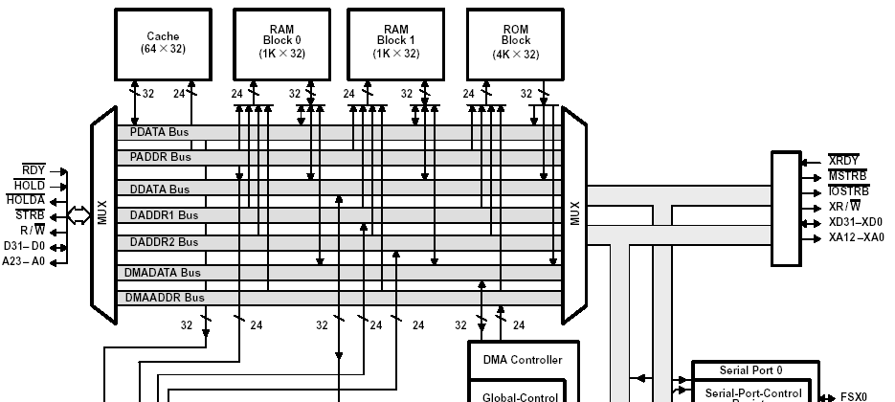
1988 – TMS320C30 from TI

Slide 30
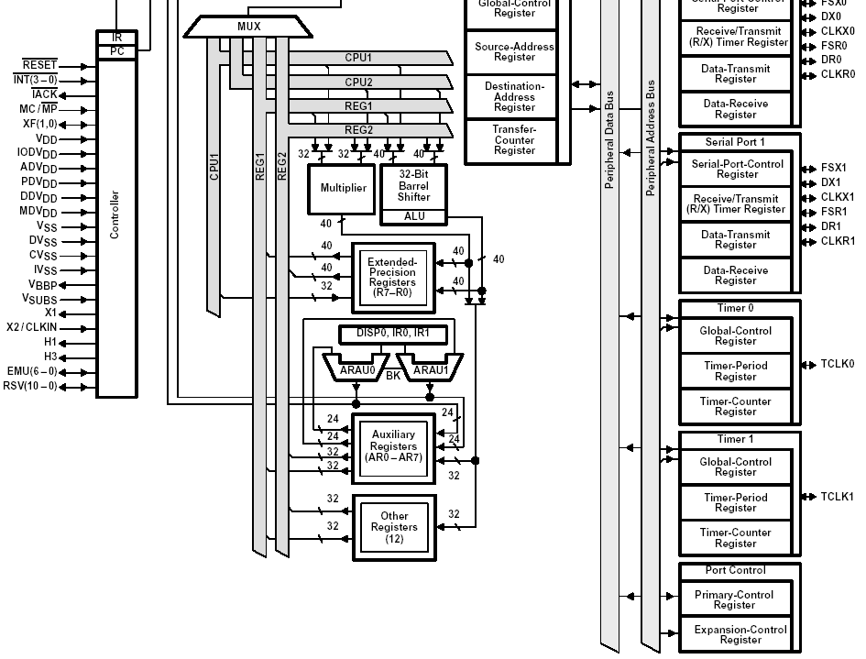
1988 – TMS320C30 from TI

Slide 31
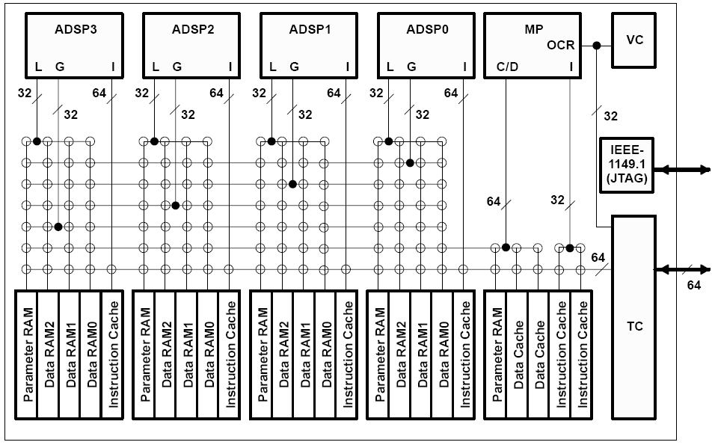
1994 – TMS320C80

Slide 32
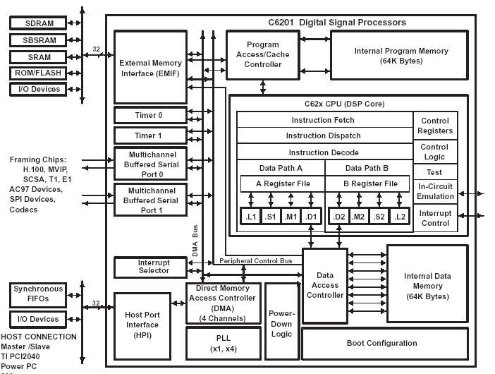
1996 – TMS320C6000 from TI

Slide 33
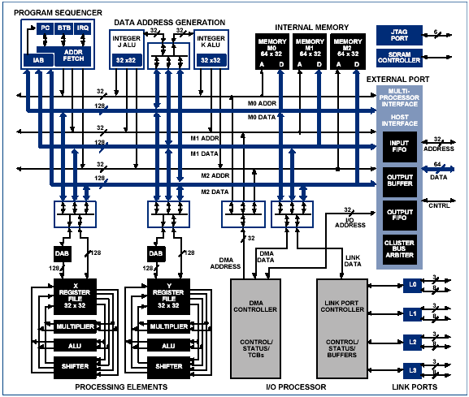
2000 – BLACKFIN from AD

Slide 34
Future – Dual Core (Analog Devices)

Slide 35
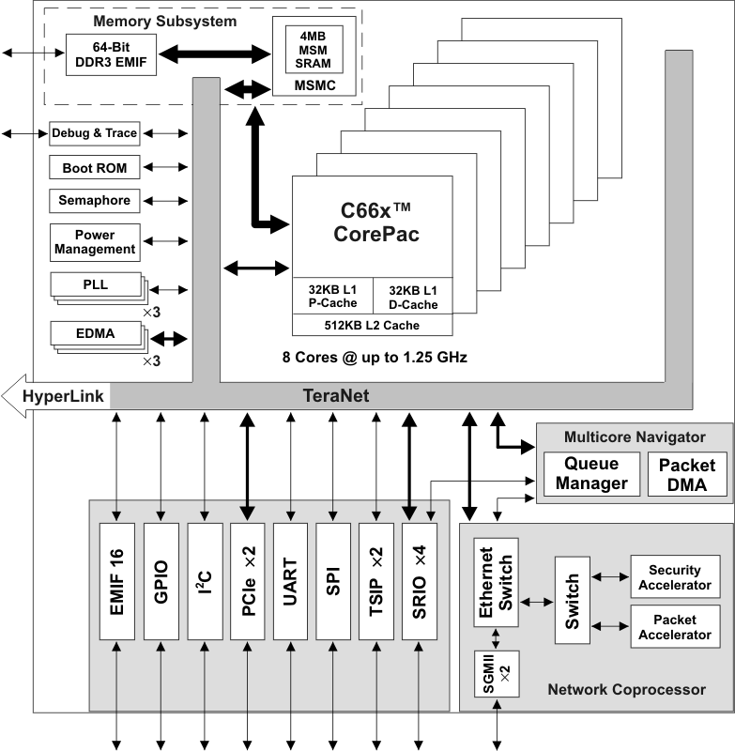
Future – Multicore Texas Instruments

Slide 36
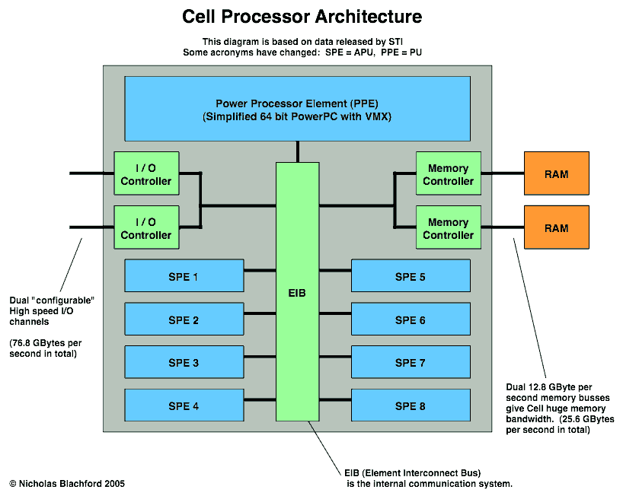
Cell (IBM, Sony e Toshiba)

Slide 37
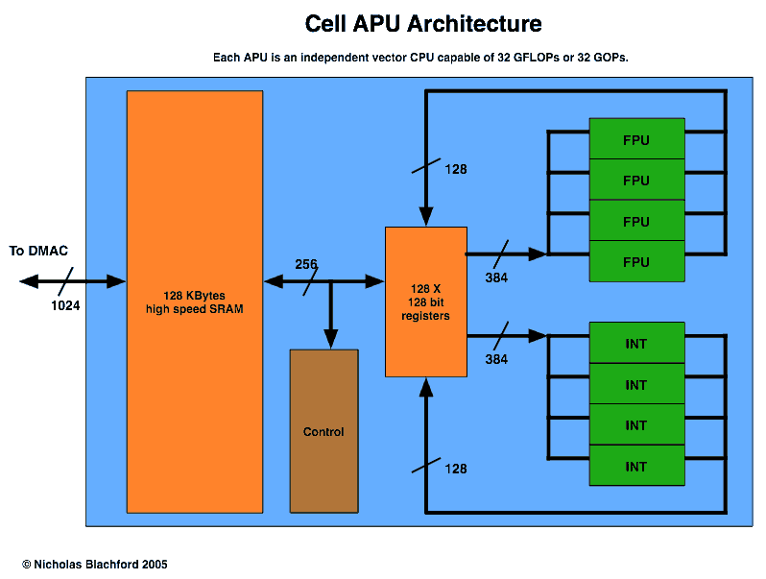
Cell (IBM, Sony e Toshiba)

Slide 38
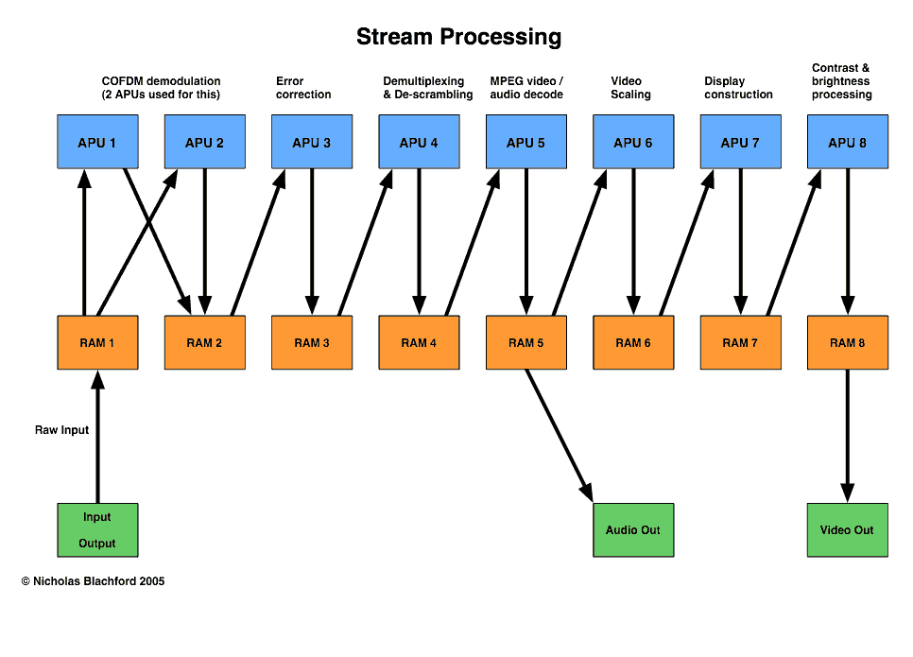
Cell (IBM, Sony e Toshiba)

Slide 39
FPGAs

Slide 40
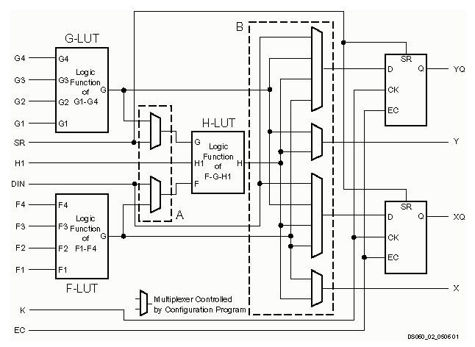
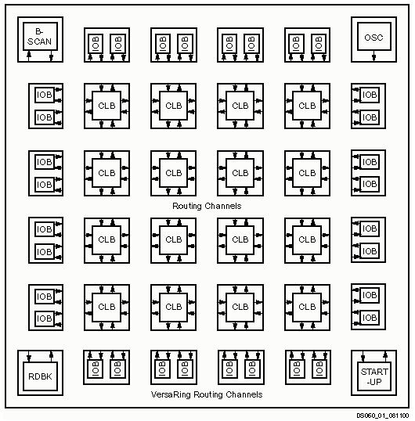
FPGAs – One Cell

Slide 41
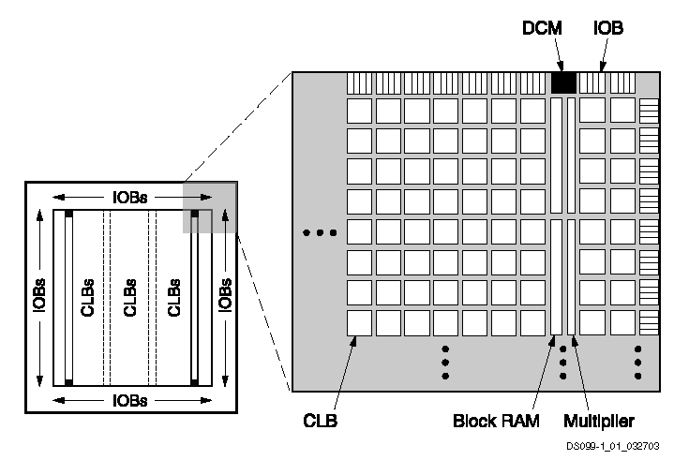
FPGAs – with Dedicated Multipliers

Slide 42
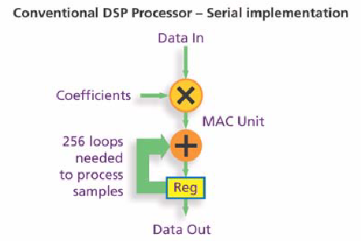
FIR on a FPGA
retirado do White Paper 212 XILINX

Slide 43
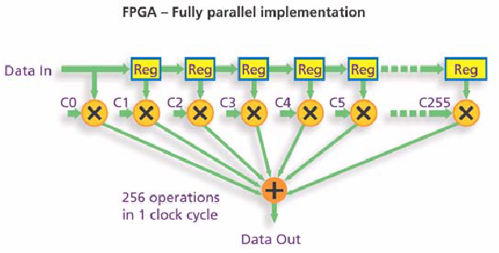
FIR on a FPGA

Slide 44
Generating MLS Pseudo-Random Sequences
1 bit

Slide 45
MLS on the C31 DSP
LOOP LDI R0,R4 ;put seed in R4
LSH -31,R4 ;move bit 31 to LSB =>R4
LDI R0,R2 ;R2 = R0 = SEED
LSH -30,R2 ;move bit 30 to LSB =>R2
ADDI R2,R4 ;add bits (31+30) =>R4
LDI R0,R2 ;R2 = R0 = SEED
LSH -28,R2 ;move bit 28 to LSB =>R2
ADDI R2,R4 ;add bits (31+30+28) =>R4
LDI R0,R2 ;R2 = R0 = SEED
LSH -17,R2 ;move bit 17 to LSB =>R2
ADDI R2,R4 ;add bits(31+30+28+17)=>R4
AND 1,R4 ;mask LSB of R4
LDIZ @MINUS,R7 ;if R4=0, R7 = MINUS value
LDINZ @PLUS,R7 ;if R4=1, R7 = PLUS value
LSH 1,R0 ;shift new seed left by 1
OR R4,R0 ;put R4 into LSB of R0
CALL AICIO_P ;output in R7 using AIC routine
BR LOOP ;repeat for next noise sample
16 instructions to generate a MLS sample

Slide 46
Bibliografia
Direct Digital Synthesis
Jeffrey H. Reed, “Software Radio”, Prentice Hall, 2002. (Chapter 4)
DSP Architecture
Phil Lapsley, “DSP Processor Fundamentals”, IEEE Press, 1997.
Paper about the DSP history
Programmable DSPs: a brief overview Lee, E.A.; Micro, IEEE , Volume: 10 , Issue: 5 , Oct. 1990, pp.14-16
Paper about the DSP evolution
The Evolution of DSP Processors Jennifer Eyre and Jef Bier, IEEE Signal Processing Magazine, Vol 17, nº 2, March 2000, pp. 43-51

