Slide 1
Software Defined Radio PhD Program on Electrical Engineering
Multirate Systems and CIC Filters
José Vieira

Slide 2
Summary
Interpolation
Decimation
Time and Frequency Multiplexing
Changing the Sampling Rate by a Rational Factor
The Noble Identities
The Polyphase Decomposition
Filter banks
The two channels case
Alias cancelation
Perfect reconstruction
Tree filter banks
Time frequency decomposition

Slide 3
Bibliography
Sebenta de Processamento Digital de Sinal do Prof. Tomás Oliveira e Silva
P. P. Vaidyanathan, “Multirate Systems and Filter Banks”, Prentice Hall, 1993.
Recommended reading from this book
Chapter 4
Sections 5.0, 5.1, 5.2, 5.3, 5.3.1, 5.3.6, 5.4, 5.5, 5.8, 5.9
Optional reading
Sections 5.6 and 5.7

Slide 4
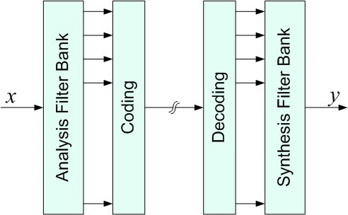
Filter Banks
The analysis filter bank splits the input signal into several frequency bands
The synthesis filter bank combines the bands into one signal
The coding or other processing is performed on each band

Slide 5
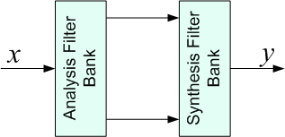
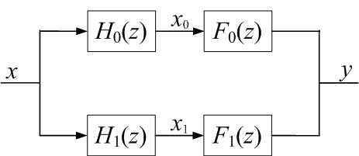
The Two Channel Case
The input signal is split into two frequency components, low and high.
The signals x₀ and x₁ only have half the bandwidth of the input signal x.
The analysis has a low pass-filter H₀(z) and a high-pass filter H₁(z). That way F₀(z) is also low-pass and F₁(z) high-pass.

Slide 6
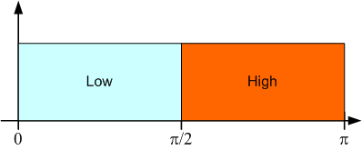
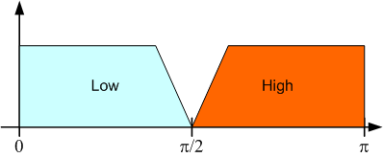
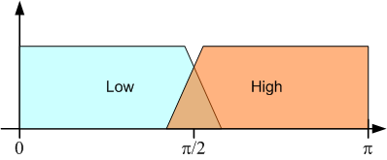
Designing the Filters
Ideal Filters
Non-overlapping Filters
Overlapping Filters

Slide 7
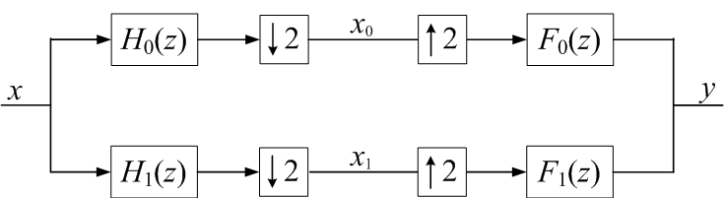
Decimated Two-Channel Filter Bank
The sampling rate of the signals x₀ and x₁ are reduced by a factor of two
The bandwidth of the signals x₀ and x₁ is also reduced by a factor of two.
Due to this, it is not possible to avoid aliasing on the the signals x₀ and x₁
Notes:
Fazer aqui uma simulação manual do sistema para h0={1,1} e x={1,1}

Slide 8
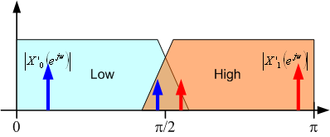
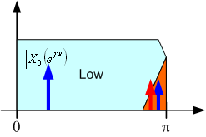
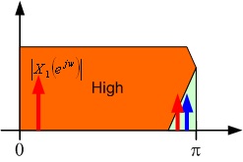
Aliasing in a Two-Channel Filter Bank
Spectrum before the decimators
Aliasing component after the decimators

Slide 9
Canceling the Aliasing
The Z transform of the output signal can be written as a function of X(z) and X(-z)
To cancel the aliasing component we should have
This can be obtained by doing

Slide 10
The Transfer Function and Perfect Reconstruction
When the alias is canceled, the filter bank has a transfer function given by
If this transfer function can be put in the form
Then we say that the filter bank has
Perfect Reconstruction

Slide 11
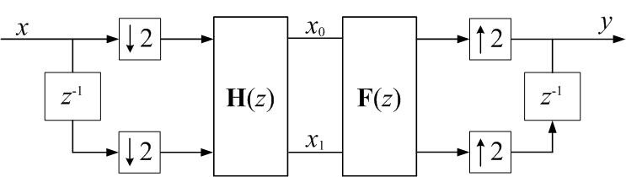
Polyphase Decomposition of a Filter Bank – Two channel case
If the filters of the two channel filter bank are represented using the polyphase decomposition we can move the decimators and expanders and get the following system
And the perfect reconstruction is obtained when

Slide 12
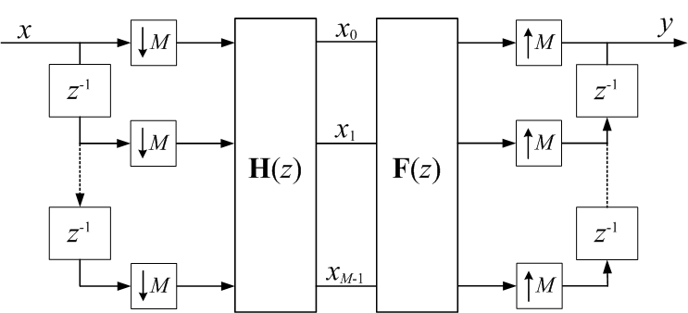
Polyphase Decomposition of a Filter Bank – The General Case

Slide 13
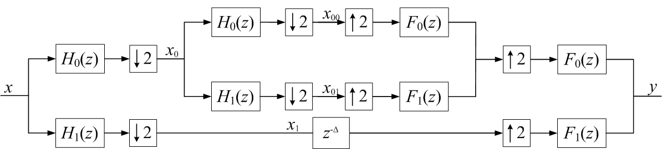
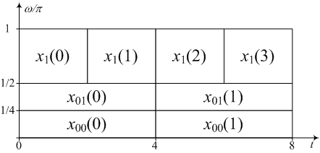
Tree Filter Banks
The time frequency decomposition

Slide 14
Cascaded Integrator-Comb (CIC) Filters
The CIC filters are an efficient implementation of “Moving Average Filters”.
A “Moving Average Filter” has the following impulse response
and the Z transform
the transfer function would be given by

Slide 15
Moving Average Filter

Slide 16
Moving Average Filter – CIC Version Cascaded Integrator-Comb Filters
Only two additions per output sample regardless the value of D

Slide 17
CIC Filters for Decimation

Slide 18
CIC Filters for Decimation – Efficient Version

Slide 19
Aliasing in Decimation with CIC Filters

Slide 20
Mth Order CIC FIlters

Slide 21
Direct Digital Synthesis – DDS

Slide 22
Direct Digital Synthesis – DDS
ROM LUT - ROM Look Up Table

Slide 23
Direct Digital Synthesis
Advantages over the analog generation of signals
Precision on the generated frequency
Flexibility. The parameters of the generated signal can be easily changed
Controlled phase on frequency changing
Smaller size
Generation of high quality signals with small distortion

Slide 24
Periodic Arbitrary Waveform
It is possible to generate any waveform by storing one period on the ROM LUT
If the period is too long we need a large memory
However, sinusoid generation is the most common case

Slide 25
Sinusoid Generation by DDS
It is possible to generate a sinusoid using DDS with a phase accumulator
Consider a continuous sine wave
The sine function is periodic because
If we consider the discrete case we will have

Slide 26
Sinusoid Generation by DDS
To have a periodic sine wave the value at the sample n must be equal to the value at the sample n+N.
This implies that
where k is an integer. Rearranging this equation we have
As N and k are integers f_{s}/f₀ must be a rational number in order the discrete sine to be periodic

Slide 27
Sine Generation with DDS
The LUT should have a complete sine period

Slide 28
Sine Generation with a Phase Accumulator
Returning to the expression of the sampled sinusoid
The phase increment φ_{inc} is also known as the normalized frequency

Slide 29
Sine Generation with a Phase Accumulator

Slide 30
Sine Generation with a Phase Accumulator
Sample points on the unit circle
in radians
Each point on the unit circle represents a sample of the sin function to store on the table
The minimum phase increment is 2π/N
This is also the frequency resolution of the generator

Slide 31
Sine Generation with a Phase Accumulator
Sample points on the unit circle
in Hertz
If we normalize to Hertz we can read directly the generated frequency
The resolution is f_{s}/N

Slide 32
Sine Generation with a Phase Accumulator
Sample points on the unit circle
normalized to N
Instead of dealing with arithmetic mod 2π we can normalize to N and work with the more convenient arithmetic mod N
The minimum frequency is achieved with a step of 1

Slide 33
Sine Generation with a Phase Accumulator
Sample points on the unit circle
normalized to N
Sin table with N samples

Slide 34
Frequency Resolution and LUT Size
If the phase increment is represented by an integer then the minimum value is 1
As the LUT has a whole sine period, if it has N samples the maximum value for the generated sine period is
Then the minimum frequency is
This f₀ corresponds to a phase increment of 1 and it is the frequency resolution of the generator

Slide 35
Frequency Resolution and LUT Size
To guarantee the frequency resolution we should have
If we have f_{s}=100MHz and f₀=10Hz then N must be larger than 1e7. We will need a counter with 24 bits and a table with 16MB.
This table size is not reasonable. Fortunately, several techniques can be used to reduce the table size.

Slide 36
Techniques to Reduce the LUT Size
Use a fractional counter where only the integer part is used to address the LUT
Store only one quadrant of the sine period
Interpolation using Taylor’s Series Expansion
Interpolation using trigonometric identities

Slide 37
Reducing the LUT Size

Slide 38
Spurious Frequencies
The main frequency of a DDS is given by
When we have the relation
Example 1: N=16 and Δ_{r}=2
Example 2: N=16 and Δ_{r}=6
We have a secondary period with 8 samples

Slide 39
Spurious Frequencies
Example 1

Slide 40
Spurious Frequencies
Example 2

Slide 41
Interpolation Using Trigonometric Identity
To increase the resolution of the sine function without increasing the size of the LUT we can use the following trigonometric identity
The angle α is a coarse table having the sine values for angles around the circle.
The angle β as a fine resolution from zero to the first value of α.

Slide 42
Interpolation Using Trigonometric Identity
Coarse angle α
Fine angle β

Slide 43
Interpolation Using Trigonometric Identity
So we can use two tables, one for α and another one for β.
However, if α_{min} is small enough, then the angle β is always close to zero, and we can simplify the previous equation

Slide 44
Interpolation Using Trigonometric Identity
With this technique is possible to evaluate the sine function with a great resolution using a small LUT and a few more calculations and two LUT reads.
Example for a LUT with 80 samples
Notes:
Adicionar as condições do gráfico

Slide 45
Main Source of Errors on DDS Systems
Amplitude truncation – lack of bits on the LUT
Phase truncation – lack of bits to address the LUT
DAC resolution – the number of bits of the DAC

