Slide 1
Software Defined Radio
PhD Program on Electrical Engineering
Sampling Theory and Quantization
José Vieira

Slide 2
Sumary
The USRP kits in the Lab
Sampling of low-pass signals
Sampling of band-pass signals
Second order sampling
Quantization

Slide 3
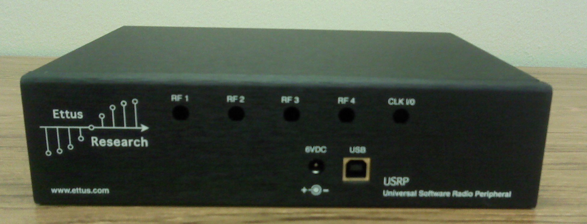
USRP 1

Slide 4
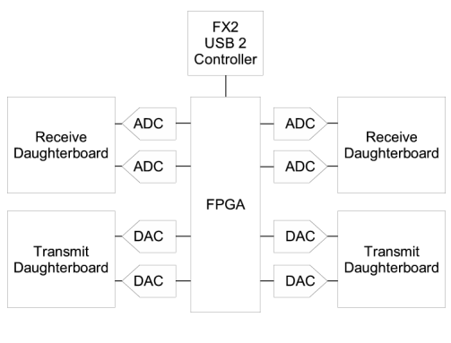
USRP
Four 12bit 64Ms/s ADCs
Four 14bit 128Ms/s DACs
USB 2.0 with 32MB/s

Slide 5
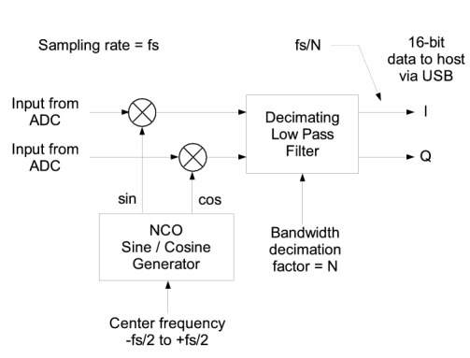
USRP – FPGA pre-programmed front-end
The FPGA has a digital down converter
The frequency of the Numerical Controlled Oscillator and the decimation factor can be changed
The output is transmitted via USB to the PC
The remaining processing is performed on the PC.

Slide 6
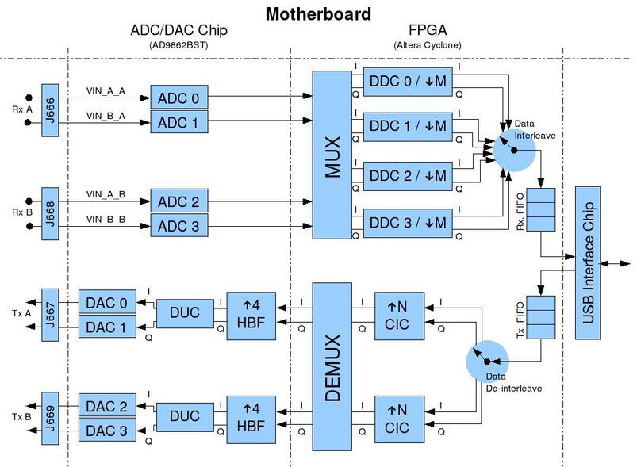
USRP – Architecture general overview

Slide 7
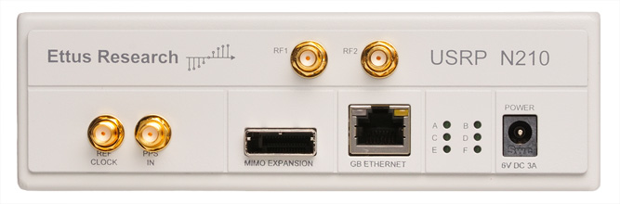
USRP 2

Slide 8
USRP 2
Use with GNU Radio, LabVIEWTM and SimulinkTM
Modular Architecture: DC-6 GHz
Dual 100 MS/s, 14-bit ADC
Dual 400 MS/s, 16-bit DAC
DDC/DUC with 25 mHz Resolution
Up to 50 MS/s Gigabit Ethernet Streaming
Fully-Coherent MIMO Capability
Gigabit Ethernet Interface to Host
Spartan 3A-DSP 3400 FPGA (N210)

Slide 9
USRP 2

Slide 10
Sampling of low-pass signals
The Sampling Theorem
We can describe the sampling process as a multiplying the signal x(t) by a pulse train of Dirac pulses
Consider a low-pass signal x(t) with bandwidth B. Then, if we sample this signal at a rate greater than 2B is possible to reconstruct the original signal from the samples.

Slide 11
Sampling of low-pass signals
In the Fourier transform domain
Fourier transform of the signal p(t)
Notes:
Colocar aqui uma figura com o pente no tempo e na freq

Slide 12
Aliasing
When the sampling frequency is not enough, aliasing occurs due to the overlap of the spectrum components

Slide 13
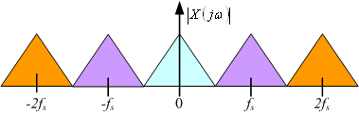
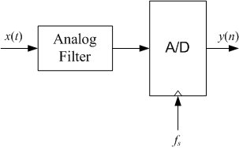
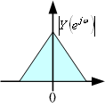
Sampling a Low-pass Signal
Low pass filter

Slide 14
Uniform sampling of band-pass signals
Consider a band-pass signal x(t) with carrier frequency f_{c} and bandwidth B.
The maximum frequency of this signal is
Using the Nyquist sampling theorem for low-pass signals the sampling frequency f_{s} for the signal x(t) should be

Slide 15
Uniform sampling of band-pass signals
For modulated signals x(t) where the frequency of the carrier f_{c} is much larger than the signal bandwidth, this form of sampling is impracticable.
However, there is a version of the Nyquist theorem for band-pass signals
If a signal as bandwidth B, then the sampling frequency f_{s} should be greater than 2B in order to be possible to recover the original signal from the samples.

Slide 16
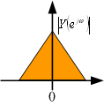
Sub-Sampling Using a Band-pass Filter
2B
2B
F_{s}=2B

Slide 17
Sub-Sampling
The sampling frequency f_{s} should be properly chosen in order to match the carrier frequency, we could have f_{c}=kf_{s}, with k an integer.
In certain systems we can use oversampling and perform the band-pass filtering in the digital domain.
As the resultant signal is oversampled it can decimated. Using polyphase decomposition of the anti-aliasing filters an efficient implementation is possible.

Slide 18
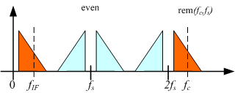
Sampling of band-pass signals
The Nyquist zones

Slide 19
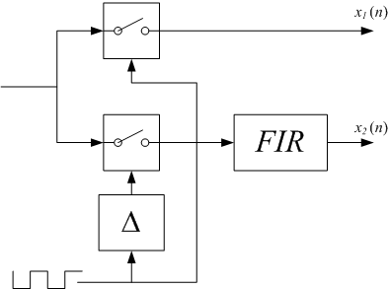
Second Order Sampling
The second order sampling is a form of sub-sampling with down conversion that gives the in-phase and quadrature components directly.

Slide 20
Second Order Sampling

Slide 21
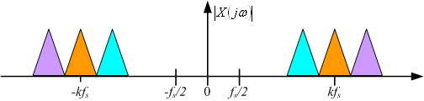
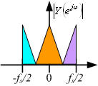
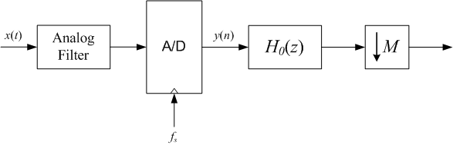
Oversampling and Digital Decimation
>2B
2B
F_{s}>2B

Slide 22
Quantization

Slide 23
Fixed Point Multiplication with the Q15 Format

Slide 24
Integer Multiplication

Slide 25
Example
0.6796875*0.9296875 =0.63189697265625
119 *87 =10353
0.1110111 *0.1010111 =00.10100001110001
=0.625

Slide 26
Fixed Point Arithmetic
Avoiding the Overflow
  Scaling
  Saturated arithmetic
Truncation
Rounding
  Rounding to the nearest
  Convergent rounding

Slide 27
Scaling
Consider a system with a frequency response having a absolute value maximum given by
To avoid the saturation of the signal numerical representation at the output of the system (overflow), we have to scale the input signal by multiplying with the scaling factor 1/A.

Slide 28
Scaling

Slide 29
Scaling on the inner points
Consider a second order IIR notch filter.
Also consider that the maximum absolute value of the frequency response is 0dB.
What would be the maximum absolute value of the frequency response of

Slide 30
Pole-zero Map

Slide 31
Frequency Response

Slide 32
Scaling in the Inner Points
To avoid the overflow on the inner point of the IIR filter we have to reduce the amplitude of the input signal by the maximum absolute value of the transfer function between the input and the inner point.
Then, in order to replace the unitary in/out gain on the pass-band we have to set an inverse gain on the output
Result: Signal to Noise ratio degradation

Slide 33
Quantization

Slide 34
Quantization
|x|≤1
q = nº of quantization steps
Δ ≈ 2/q , quantization step
b = nº of quantization bits
q = 2^{b}

Slide 35
Quantization
|x|≤1
q = nº of quantization steps
Δ ≈ 2/q , quantization step
b = nº of quantization bits
q = 2^{b}

Slide 36
Quantization Noise

Slide 37
Signal to Quantization Noise Ratio
The signal to quantization noise ratio is a function of the number of bits.
Each extra bit reduces the signal to noise ratio by 6dBs
With 16 bits we get around 100dB of signal to noise ratio

Slide 38
Scaling and Quantization Noise
If in a 16 bit system the scaling factor is set to A=256, then the signal to noise ratio will be 52dB instead of 100dB
Note that if we have used a floating point arithmetic the scaling of the inner point was not necessery. The signal to noise ratio would be 100dB.

Slide 39
Rounding Error on FIR Filters
16bits Accumulator

Slide 40
Rounding Error in FIR Filters
The quantization noise does
not increase with the
number of coeficients
32bits Accumulator

Slide 41
Rounding Error on IIR Filters
For the IIR filters, due to the feedback, an accumulator with extra bits does not solve the quantization error problem.
Stability issues when the poles are near the unitary circle. Due to the quantization problems the poles could be moved to out of the unitary circle.
Limit cycles, which are small output periodic signals when no input is applied.

Slide 42
Effects of the Filter Coefficients Quantization
FIR filters
  The frequency response of the filter with the quantized coefficients can be quite different of the designed one
  This can be a difficult problem to solve for filters with a large number of coefficients.
IIR filters
  Stability problems due to the placement of the poles near the unit circle
  The frequency response of the quantized version can be quite different due to the high precision needed for the pole-zero placement

Slide 43
Non-uniform Quantization
If the Probability Density Function (pdf) of the input signal is known we can take advantage of this knowledge using non-uniform quantization.
The uniform quantizer is optimal only for signals with a constant pdf.
Example: The voice signal has a Laplacian pdf. The small amplitudes are more probable than the larger ones.
Notes:
Ser mais rigoroso na apresentação da quantização não uniforme ideal

Slide 44
Signal with a Laplacian PDF

Slide 45
Dithering
When the amplitude of the signal is too small when compared with the minimum quantization step, is possible to obtain a digital representation of this signal by using dithering
Dithering example with 5 levels of quantization {-1,0.5,0,0.5, 1} and thresholds on {-0.5,-0.25,0.25,0.5}
Notes:
Melhorar a descrição do dithering e introduzir referências

Slide 46
Dithering
A dithering signal with an uniform distribution with a maximum amplitude equal to half the quantization step has the effect of flatting the quantization noise spectrum.

Slide 47
Bibliography
John G. Proakis and Dimitris G. Manolakis, “Digital Signal Processing, Prentice Hall, 2007. (Chapter 9)
Jeffrey H. Reed, “Software Radio”, Prentice Hall, 2002. (Chapter 5)

