Slide 1
Tecnologias Digitais para
Sistemas de Rádio Definidos por Software
Nuno Borges Carvalho
José Neto Vieira
Radio Transceivers
Digital Technologies for Software Defined Radio Systems

Slide 2
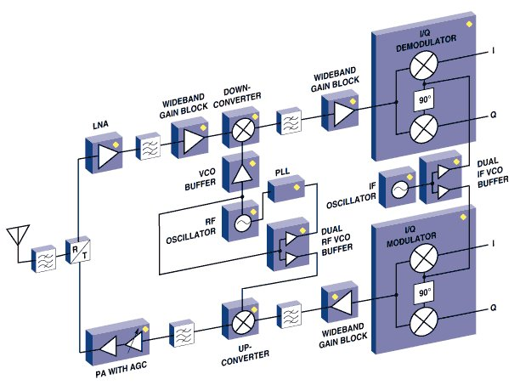
Software Defined Radio
Analog Radio
  Conversion made by hardware
  Filtering and demodulation done with electronic components

Slide 3
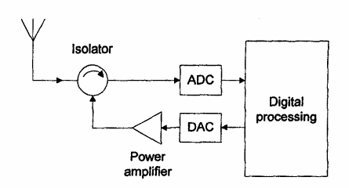
Software Defined Radio
Software Defined Radio
  Radio in which the processing is completelly digital.
Joe Mitola says, "A software radio is a radio whose channel modulation waveforms are defined in software. That is, waveforms are generated as sampled digital signals, converted from digital to analog via a wideband DAC and then possibly upconverted from IF to RF. The receiver, similarly, employs a wideband Analog to Digital Converter (ADC) that captures all of the channels of the software radio node. The receiver then extracts, downconverts and demodulates the channel waveform using software on a general purpose processor."
J. Mitola, “The software radio architecture,” IEEE Communications Magazine, vol. 33, nº 5, pp. 26–38, May 1995

Slide 4

Software Defined Radio
A Software Defined Radio (SDR) system is a radio communication system where components that have typically been implemented in hardware (i.e. mixers, filters, amplifiers, modulators/demodulators, detectors. etc.) are implemented using software on a personal computer.
Definition by SDR Forum-
Software defined radio is used to describe radios that provide software control of a variety of modulation techniques, wide-band or narrow-band operation, communications security functions (such as hopping), and waveform requirements of current and evolving standards over a broad frequency range.

Slide 5
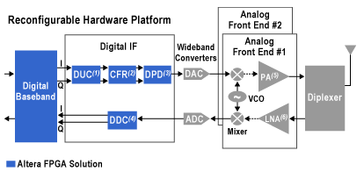
Software Defined Radio
Actual SDR systems ….
Some parts in the analog domain, some parts in the digital domain.

Slide 6
Software Defined Radio
SDR has been conquering the analog world, moving from base band to RF.
Antenna
RF
IF
Baseband
ADC/DAC
DSP
Bandpass
Filter
Variable
Frequency
Oscillator
Local
Oscillator

Slide 7
Software Defined Radio
SDR has been conquering the analog world, moving from base band to RF.
Antenna
RF
IF
Baseband
All Digital
ADC/DAC
DSP
Variable
Frequency
Oscillator

Slide 8
Software Defined Radio
SDR has been conquering the analog world, moving from base band to RF.
Antenna
RF
IF
Baseband
All Digital
All Digital
ADC/DAC
DSP

Slide 9
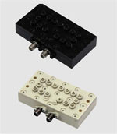
Software Defined Radio
.
In a real SDR, multi-band and multi-standard we should be aware of:
  Adaptive filtering in order to reduce noise and subsequently increase of SNR.
  Guarantee the out-of-band rejection for all standards and change in bandwidth.

Slide 10
Software Defined Radio
Sensitivity is the minimum power a receiver can have at the input in order to guarantee a minimum SNR.
NF is called the noise figure, k is the Boltzmann constant, T the room temperature and B the bandwidth.

Slide 11
Software Defined Radio
Dynamic range is nothing more that the difference between the minimum and the maximum power the transceiver (receiver) can dealt with.
Where P_{max} is normally calculated as the maximum power that will saturate the receiver front end, so that the auto-generated nonlinear distortion is similar to the seek SNR.

Slide 12
Software Defined Radio
.
Problems associated with large signal variations, mainly dynamic range limitations.

Slide 13
Software Defined Radio
.
At the transmitter PAPR can degrade
  Digital to Analog Converters – DAC
  Power Amplifiers
At Receiver
  Analog to Digital Converter

Slide 14
Software Defined Radio
.
In the transmitter.

Slide 15
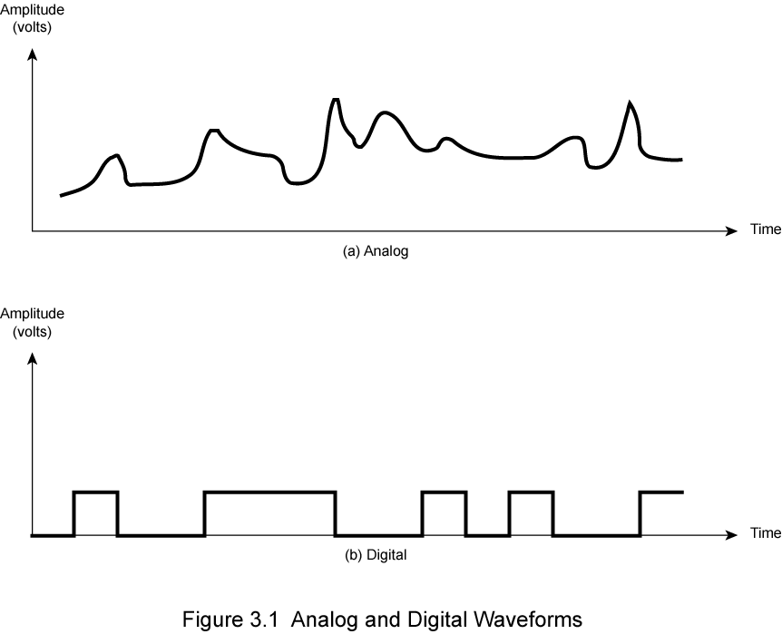
Software Defined Radio
Analog Data.
Digital Data.

Slide 16
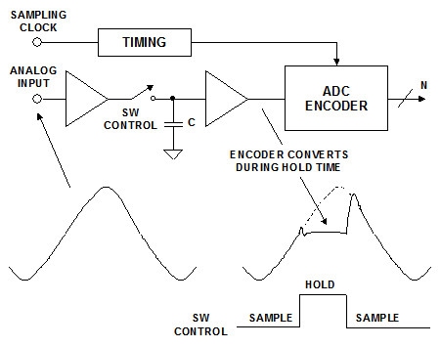
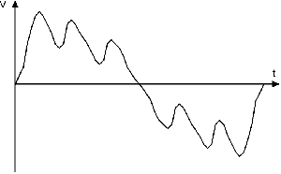
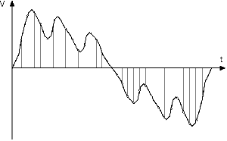
Software Defined Radio
Sampling
Output is a replica of the input at certain instants of time.

Slide 17
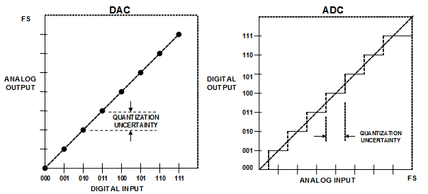
Software Defined Radio
Quantization
Actually transform the input signal amplitude into several quantizer levels Q=2N-1
Quantization error:
Quantization interval:

Slide 18
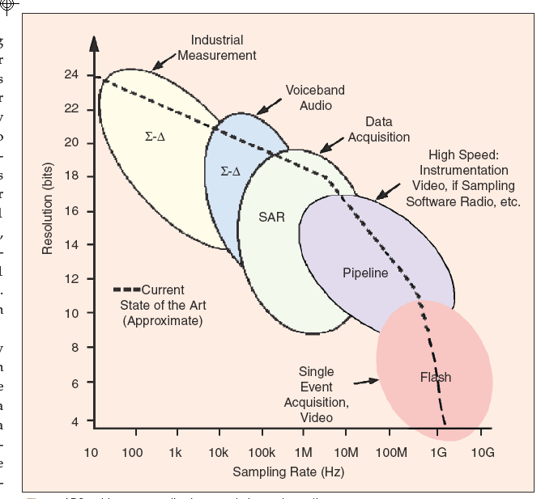
Software Defined Radio
Several configurations can be used for ADC’s:
  Flash ADC
  Delta-tracking, uses DAC’s
  Ramp-compare ADC;
  Sigma-Delta .
  Pipeline

Slide 19
Software Defined Radio
.
Ideal transmitter in SDR:
  PWM modulator, digital signals goes till the antenna:

Slide 20
Cognitive Radio
.
By cognitive we can understand:
Original definition by Joseph Mitolla (1999)
A radio that employs model based reasoning to achieve a specified level of competence in radio-related domains
Simon Haykin’s Definition:
An ambient-aware, intelligent radio which learn from its surroundings and adapt itself to:
  Highly reliable communication, anywhere, anytime;
  Efficient use of Radio Spectrum;

Slide 21
CR
Increasing use of software in advanced radios
PBAR
.
SR
Hardware radio includes firmware and therefore may have significant operational flexibility.
Ideal Software Radio
SCR + SDR baseband + SDR RF
SDR
Increasing Flexibility and Reconfigurability
SCR + SDR baseband (for some applications)
SCR
Hardware Radio
1995
2005
2015
2025
1995: First RFI on SDR
2004: First SDR device approved by FCC
Note: SDR currently is practical for some applications such as commercial wireless basestations, but not for some wireless handsets. Cost, power, size and weight are critical design requirements that must be considered when considering the use of advanced radio technologies.
CR – Cognitive Radio PBAR – Policy-Based Adaptive Radio
RFI – Request for Information SCR – Software Controlled Radio
SDR – Software Defined Radio SR – Software Radio
IEEE 1900 Committee

Slide 22
Cognitive Radio
.
RF Resource Request
Develop Request
Process Request
Determine Opportunities
RF Transmit Plan
Select Opportunities
Bound: Yes/No
Unbound: Binding
Constraints

Slide 23
Cognitive Radio
Non Cognitive Radios:
Cognitive Radios:

Slide 24
Cognitive Radio
In a cognitive radio we should be able to:
Create our own waveforms,
Negotiate different interfaces
Maintain QoS be managing is radio
Practically it should be:
SDR +
Have some kind of intelligence
Environment aware
Be capable of sensing the environment

Slide 25
Cognitive Radio
Cognition cycle
Infer from Context
Orient
Infer from Radio Model
[Mitola_99]
Establish Priority
Pre-process
Normal
Select Alternate
Goals
Parse Stimuli
Urgent
Plan
Immediate
Learn
Observe
New
States
Decide
States
User Driven
(Buttons)
Generate “Best”
Waveform
Autonomous
Outside
World
Act
Allocate Resources
Initiate Processes
Negotiate Protocols

Slide 26
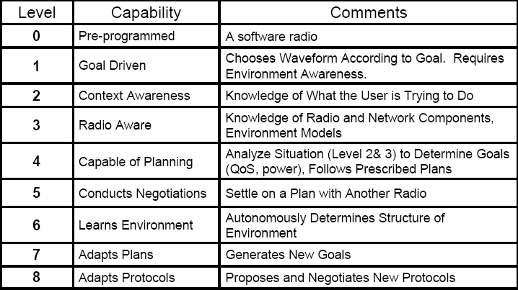
Cognitive Radio

Slide 27
Cognitive Radio
Sensing Radio
Wideband antenna, PA and LNA
ADC and DAC should have high sampling rates and moderate resolution
Simultaneous Tx and Rx
Allows MIMO
Physical Layer
OFDM Transmission
Spectrum monitoring
Frequency selection, modulation and dynamic power control
Non ideal equalization of the analog parts
MAC Layer
Optimize the transmission parameters
Adaptive change of the transmission rates
Negotiate resources
PA
D/A
IFFT
MAE/
POWER CTRL
ADAPTIVE
LOADING
TIME, FREQ,
SPACE SEL
QoS vs.
RATE
LNA
A/D
FFT
CHANNEL
SEL/EST
INTERFERENCE
MEAS/CANCEL
LEARN
ENVIRONMENT
FEEDBACK
TO CRs
RF/Analog Front-end
Digital Baseband
MAC Layer

